Slide 1
Harnessing Context Incongruity for Sarcasm Detection
Aditya Joshi, Vinita Sharma, Pushpak Bhattacharyya

Slide 2
Introduction
The past work detects sarcasm with specific indicators.
(a) unigrams and pragmatic(语用特征) features, such as
emoticons
Gonzalez-Ibanez et al., 2011; Carvalho et al., 2009; Barbieri et al., 2014
(b) extraction of common patterns, such as
hashtag-based sentiment
Maynard and Greenwood, 2014; Liebrecht et al., 2013
a positive verb being followed by a negative situation
Riloff et al., 2013
discriminative n-grams
Tsur et al., 2010a; Davidov et al., 2010
However, we believe that it is time that sarcasm detection is based on well-studied linguistic theories. In this paper, we use one such linguistic theory: context incongruity (语境不一致)

Slide 3
Contribution
A sarcasm detection system that is grounded on a linguistic theory (context incongruity)
based on two kinds of incongruity: Explicit, Implicit
outperforms two state-of-art sarcasm detection systems (Riloff et al., 2013; Maynard and Greenwood, 2014)
an improvement for short ‘tweets’ as well as long ‘discussion forum posts’.
Introduce inter-sentential (句子间) incongruity for sarcasm detection
that expands context of a discussion forum post by including the previous post (also known as the ‘elicitor’ post) in the discussion thread.
Sarcasm detection research can push the frontiers by taking help of well-studied linguistic theories.

Slide 4
Context Incongruity
Context incongruity is a necessary condition for sarcasm (Campbell and Katz, 2012).
Incongruity is defined as ‘the state of being not in agreement, as with principles’
The sarcasm processing time (time taken by humans to understand sarcasm) depends on the degree of context incongruity between the statement and the context (Ivanko and Pexman, 2003).

Slide 5
Types of Incongruity
Explicit incongruity
Covertly expressed through sentiment words of both polarities
“I love being ignored”
The converse(逆命题) is not true
“The movie starts slow but the climax is great”
Implicit Incongruity
Covertly expressed through phrases of implied sentiment, as opposed to opposing polar words
“I love this paper so much that I made a doggy bag out of it”
the only polar word is ‘love’. However, the clause ‘I made a doggy bag out of it’ has an implied sentiment that is incongruous with the polar word ‘love’.

Slide 6
Types of Incongruity
Estimating prevalence
A naive, automatic evaluation on a dataset of 18,141 sarcastic tweets.
Around 11% sarcastic tweets have at least one explicit incongruity (presence of positive and negative words).
We also manually evaluate 50 sarcastic tweets
10 have explicit incongruity
others have implicit incongruity

Slide 7
Feature Design: Explicit Incongruity
An explicit incongruity giving rise to sarcasm bears resemblance to thwarted(挫败) expectations.
‘I love the color. The features are interesting. But a bad battery life ruins it’.
Hence, our explicit incongruity features are a relevant subset of features from a past system to detect thwarting by Ramteke et al. (2013).
Number of sentiment incongruities
The number of times a positive word is followed by a negative word, and vice versa
Largest positive/negative subsequence
The length of the longest series of contiguous (紧挨着) positive/negative words
Number of positive and negative words
Lexical(词汇的) Polarity
The polarity based purely on the basis of lexical features, as determined by Lingpipe SA system (Alias-i, 2008)
Note that the ‘native polarity’ need not be correct.

Slide 8
Feature Design: Implicit Incongruity
We use phrases with implicit sentiment as the implicit incongruity features.
These phrases are sentiment-bearing verb and noun phrases
e.g. ‘getting late for work’
For this, we modify the algorithm given in Riloff et al. (2013) in two ways
(a) Extract only positive verbs and negative noun situation phrases
We generalize it to both polarities
(b) Remove subsumed phrases
We retain both phrases
i.e. ‘being ignored’ subsumes ‘being ignored by a friend’

Slide 9
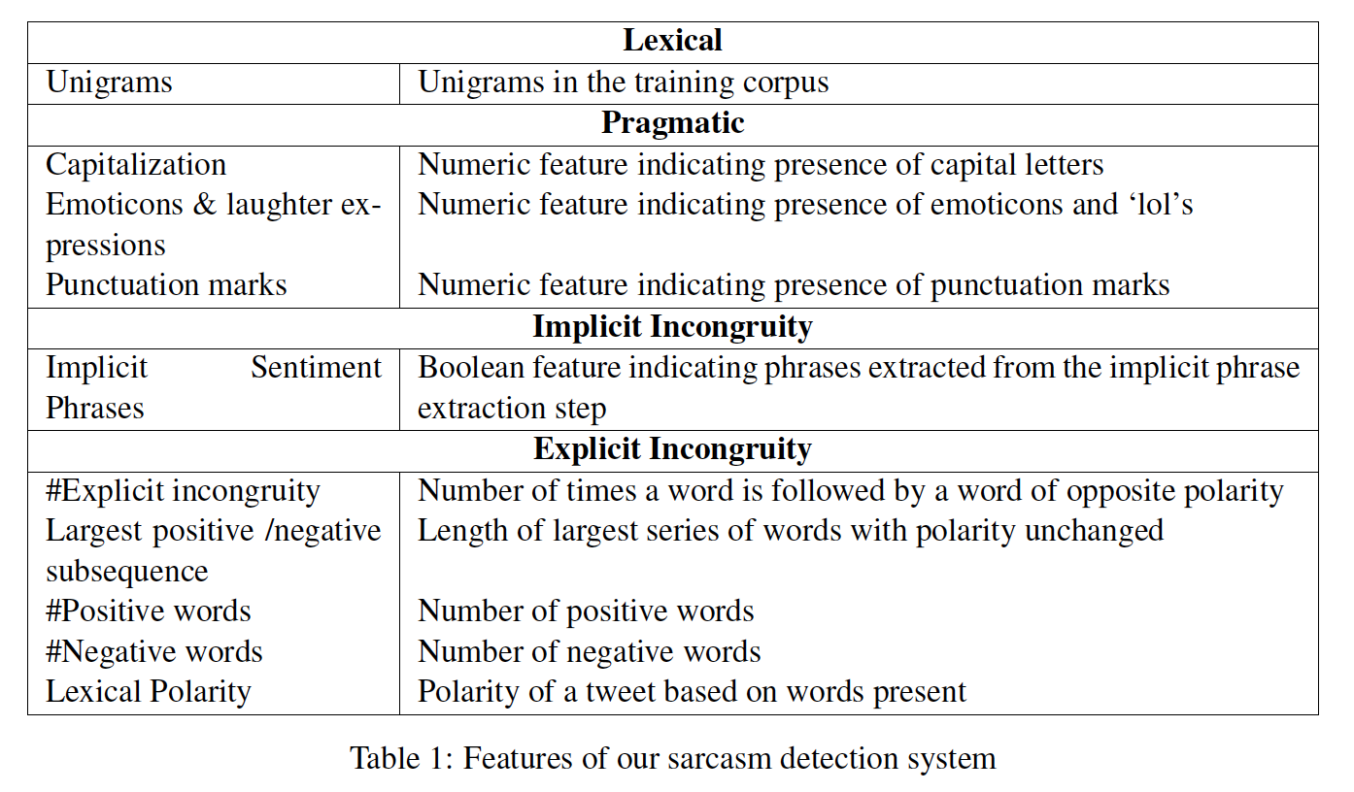
Feature Design
(语用学)

Slide 10
Dataset
Three datasets to evaluate our system
Tweet-A (5208 tweets, 4170 sarcastic)
tweets with hashtags #sarcasm and #sarcastic as sarcastic
tweets with hashtags #notsarcasm and #notsarcastic as non-sarcastic
A rough glance through the tweets is done, and the ones found to be wrong are removed
The hashtags mentioned above are removed
Tweet-B (2278 tweets, 506 sarcastic)
This dataset was manually labeled for Riloff et al. (2013)
Discussion-A (1502 discussion forum posts, 752 sarcastic)
This dataset is created from the Internet Argument Corpus (Walker et al., 2012) that contains manual annotations for sarcasm.
We randomly select 752 sarcastic and 752 non-sarcastic discussion forum posts.

Slide 11
Experimental Setup
To extract the implicit incongruity features
we run the iterative algorithm described in Section 4.2, on a dataset of 4000 tweets
50% sarcastic
created using hashtag-based supervision
The algorithm results in a total of
79 verb phrases
202 noun phrases
We train our classifiers for different feature combinations
using LibSVM with RBF kernel (Chang and Lin, 2011)
report average 5-fold cross-validation values

Slide 12
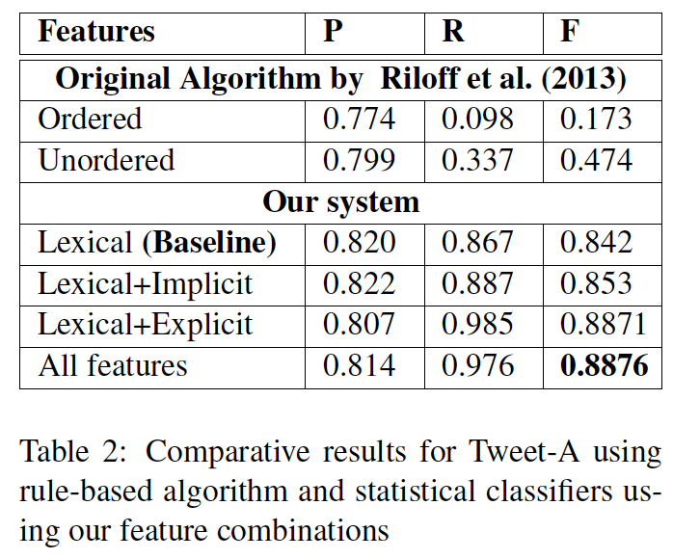
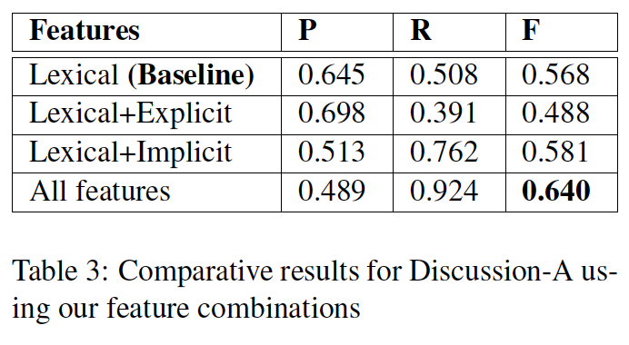
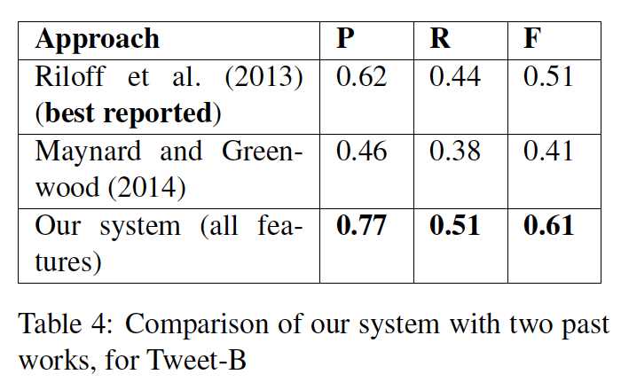
Results
Precision (P), Recall (R) and F-score(F)
The table first reports values from a re-implementation of Riloff et al. (2013)’s two rule-based algorithms:
the ordered version predicts a tweet as sarcastic if it has a positive verb phrase followed by a negative situation/noun phrase
the unordered does so if the two are present in any order.

Slide 13
Analysis: Inter-sentential incongruity
Our system performs worse for Discussion-A than Tweet-A/B possibly because of incongruity outside the text.
Because of the thread structure of discussion forums, sarcasm in a ‘target post’ can be identified using the post preceding it (called ‘elicitor post’)
We compute the five explicit incongruity features for a concatenated version of target post and elicitor post (elicitor posts are available for IAC corpus, the source of Discussion-A).
The precision rises to 0.705 but the recall falls to 0.274
A possible reason is that only 15% posts have elicitor posts, making the inter-sentential features sparse.
That notwithstanding, our observation shows that using the inter-sentential context is an interesting direction for sarcasm detection.

Slide 14
Error Analysis
Subjective polarity
The tweet ‘Yay for 3 hour Chem labs’ is tagged by the author as sarcastic, which may not be common perception.
No incongruity within text
As stated in Section 2, our system does not detect sarcasm where incongruity is expressed outside the text. About 10% misclassified examples that we analyzed, contained such an incongruity.
Incongruity due to numbers
Our system could not detect incongruity arising due to numbers
as in ‘Going in to work for 2 hours was totally worth the 35 minute drive.’.
Dataset granularity (粒度)
Some discussion forum posts are marked as sarcastic, but contain non-sarcastic portions, leading to irrelevant features.
i.e. ‘How special, now all you have to do is prove that a glob of cells has rights. I happen to believe that a person’s life and the right to life begins at conception’.
Politeness
In some cases, implicit incongruity was less evident because of politeness
as in, ‘Post all your inside jokes on facebook, I really want to hear about them’.

